Slide 1
Exploring the use of LID in learning disentangled and cluster-friendly latent spaces in Autoencoders
Presented by: Subhodeep Ghosh (sg2646)
Program, Department: PhD student in Computer Science
Course: Dimensionality and Scalability in AI (CS786854)
Date: 05/02/2024

Slide 2
Problem Statement, Significance and Goals
Problem Statement:
To explore the various ways we can utilize local intrinsic dimensionality (LID) of data in latent space to achieve disentangled or cluster-friendly latent spaces
Needs and Significance:
Latent representations encoded by deep neural networks are often an entangled mesh of variations coming from different features
Dimension reduction is a crucial preprocessing step in clustering problems
The latent space produced by such reductions, may not be cluster friendly though
Project Goals:
First investigating both theoretically and empirically the prospect of learning disentangled representations by utilizing LID via Total Correlation. Then investigating how LID can help form smoother, more separable clusters in the latent space produced by an Autoencoder.
Notes:
scRNA-seq allows researchers to study cell heterogeneity at the cellular level. A crucial step to analyze such data is to cluster cells into subpopulations to facilitate subsequent downstream analysis. However clustering such high-dimensional, noisy and sparse transcriptional profiles is a challenging task. So dimension reduction is a crucial step to extract the most informative features before clustering. Conventional methods in this regard either ignore the distance and affinity constraints or make some latent space assumption like Gaussian distribution of data that fails to learn cluster-friendly low-dimnesional space.
This paper aims to combine dimension reduction using a denoising autoencoder to characterize scRNA-seq data while clustering the cell population in latent space using a soft self-training Kmeans algorithm (as shown by the schematic diagram here) which can effectively aggregate similar cells and pursue a more cluster-friendly latent space. The method is named scziDesk. We will go into the details behind scziDesk’s architecture in the latter slides but first we need to get some background.

Slide 3
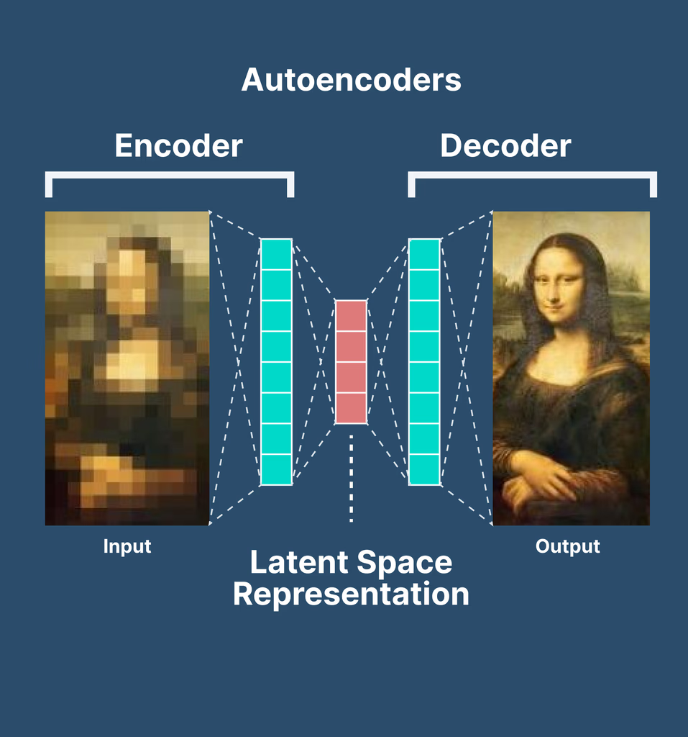
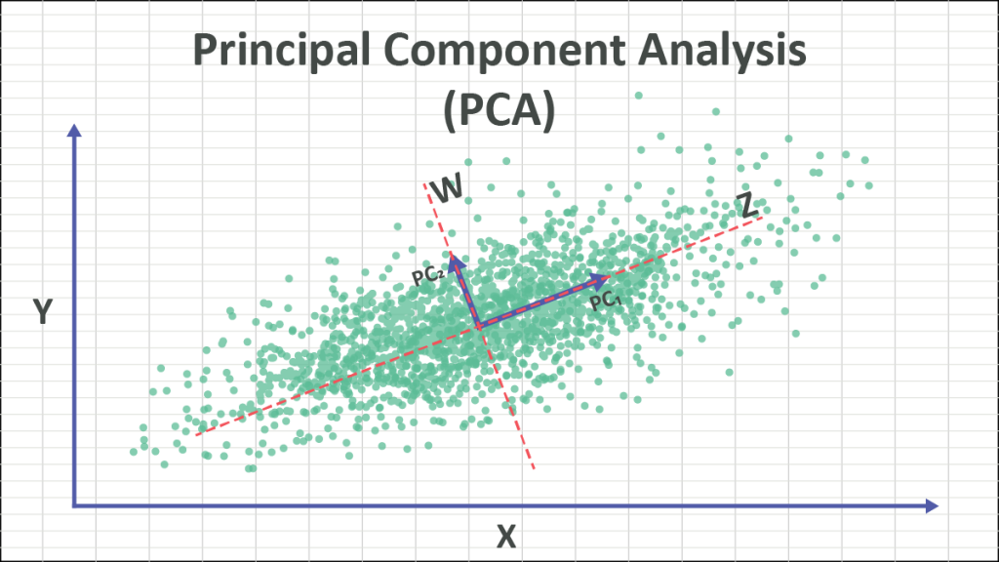
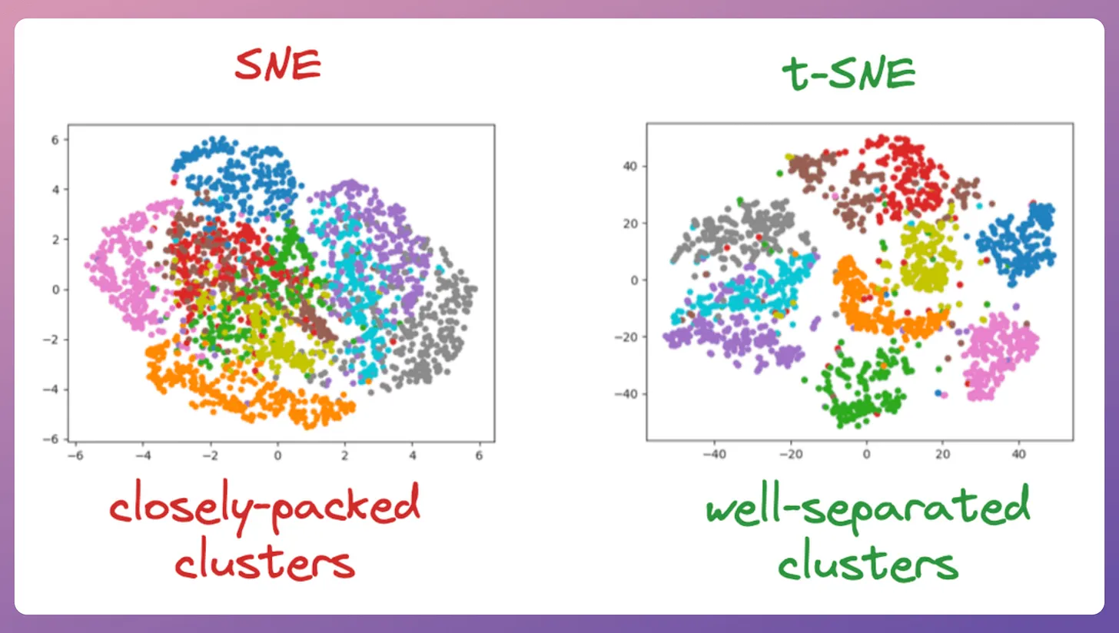
Introduction
Understanding Dimension Reduction
Most datasets (e.g., images or sensor data) are in high-dimensional spaces but lie on a lower-dimensional manifold.
The curse that plagues data scientists - “Curse of dimensionality”
Lot of noisy and redundant features in higher dimensions
Problem of visualization and interpretation
Existing models for Dimension Reduction include:
Notes:
2. As the number of features grows, the volume of the space grows exponentially. Distances between points become meaningless, data become sparse, and many algorithms degrade in performance or require vastly more samples to generalize
3. High‑dimensional measurements often include correlated or irrelevant features. Dimension reduction techniques project onto the most informative directions, filtering out noise and redundancy, which can improve downstream tasks
4. Humans can’t directly visualize beyond 3 dimensions. By embedding into 2 or 3 dimensions, you can inspect structure, clusters, or manifolds in your data.
PCA - Finds orthogonal directions of maximum variance; projects data onto top‑k PCs.
SNE - Nonlinear embedding preserving local neighborhood probabilities using Gaussian kernel
t-SNE - Use student’s T distribution instead of Gaussian kernel
Autoencoder - Neural network trained to reconstruct input via a bottleneck latent layer.

Slide 4
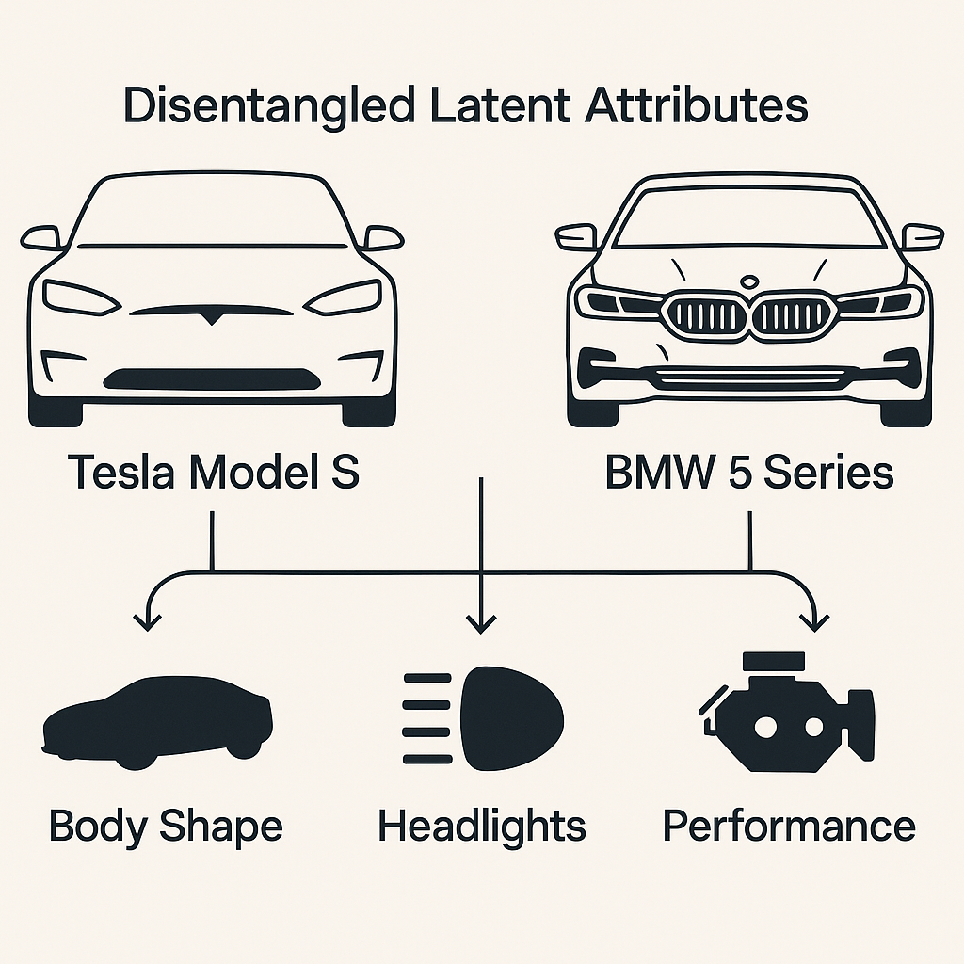
Introduction
What is disentanglement?
The problem of entanglement
Autoencoders are trained to compress input data into such latent representations, retaining only the most essential features while filtering out extraneous or redundant dimensions.
The representations are still an entangled ensemble of variations coming from various features of the data
Makes it harder to directly interpret the representations
Thus it is essential to enforce disentanglement in order to increase the interpretability
Notes:
Latent spaces produced by autoencoders are comprised of latent dimensions or features that capture the complex non-linear structure of the data in a lower-dimensional space -> much closer to its true manifold.
Autoencoders by themselves are not responsible for such disentanglements. Their objective is to compress the data in a lower dimensional space from which much of the original data can be reconstructed. Thus they minimize only the reconstruction loss of the data. It is therefore necessary to modify the objective of autoencoders.

Slide 5
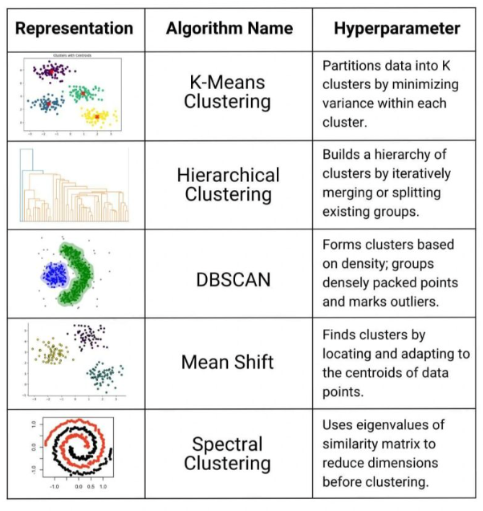
Introduction
Types of clustering
Clustering in latent spaces
Clustering is an unsupervised machine learning technique used to group similar unlabeled data points into clusters based on defined similarity measures.
Clustering high dimensional data poses several challenges
The learnt representations are not inherently cluster friendly
They aren’t guaranteed to align with meaningful or well-separated clusters unless explicitly guided to do so
Notes:
Clustering high dimensional data poses several challenges - first being curse of dimensionality directly affecting clustering as distance become meaningless. Also it increases the computational cost and time.

Slide 6
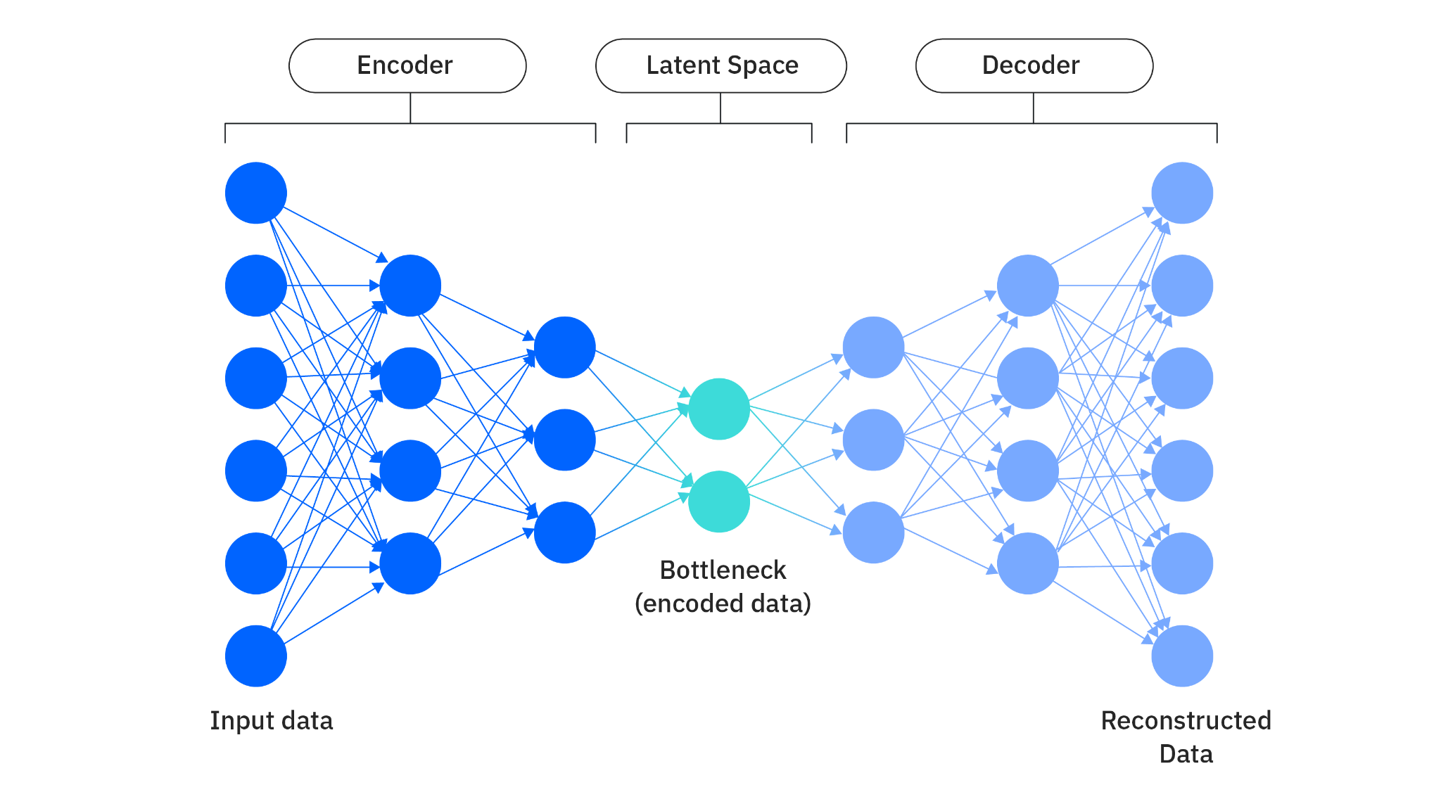
Background
Autoencoders
Autoencoders are neural networks based dimensionality reduction models that capture nonlinear relationships in the data
An encoder responsible for compressing the data to latent space
A bottleneck dimension characterizing the latent space
A decoder for reconstructing the data from latent space
Training involves minimizing the reconstruction error.
Notes:
A bottleneck dimension deciding how many features the latent space has
The representations learnt are often entangled and hard to interpret because it is trained only for reconstruction, not for explicit factor separation.

Slide 7

Background
Total feature space
TC > 0
Total Correlation
Total Correlation (TC) quantifies the amount of total information in a set of variables beyond what would be there if the variables were independent.
TC uses entropy as a measure of information contained in a variable.
TC of this feature space is some positive value > 0. In a disentangled feature space, the TC measured will be 0
Notes:
Total Correlation (TC), also known as multi-information, is a generalization of mutual information for measuring dependence among more than two random variables.
it is worthwhile to explore the use of intrinsic dimensionality as a proxy for entropy in TC and come to a theoretical and practical agreement on whether this approach is actually fruitful

Slide 8
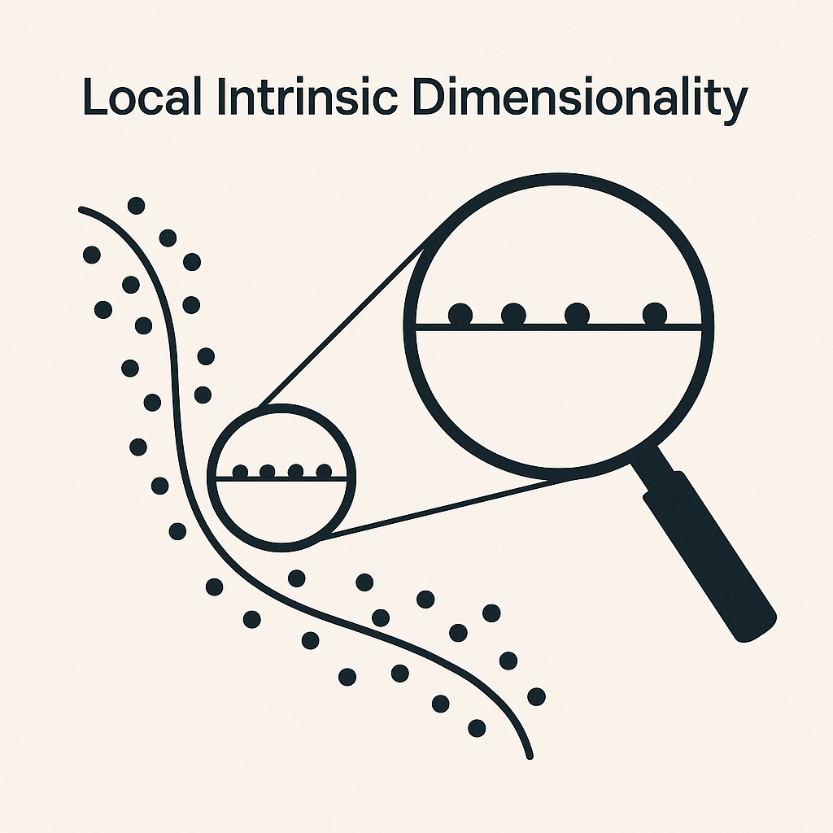
Background
Local Intrinsic Dimensionality (LID)
Intrinsic dimensionality is the minimum number of independent variables required to describe a dataset without loss of its intrinsic structure.
The winding curve on the left represents a high‑dimensional data space
Zooming in the manifold in which the data lies looks almost flat and one‑dimensional in a tiny neighborhood. LID asks: how many directions do I actually need, locally, to move around this point?
Notes:
It is the complexity of the data itself, even if it’s in a very high-dimensional space.

Slide 9
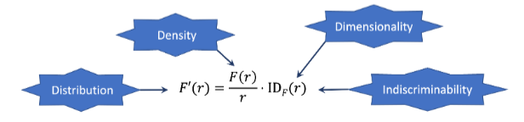
Background
Local Intrinsic Dimensionality
Mathematically, LID is the rate at which the neighborhood distribution around a point normalized by the density around the point at a specific distance r, given by:
As we tend r towards 0, we get the asymptotic tail distribution. It tells us in how many orthogonal directions we can move around a point. If we can move in just one direction (say up or down), the asymptotic LID around that point is 1.
Notes:
It is the complexity of the data itself, even if it’s in a very high-dimensional space.

Slide 10
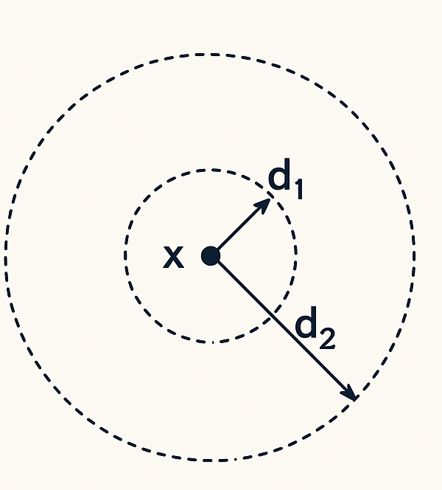
Background
Two-NN estimator
Two-NN estimator of LID
There are various LID estimators such as Maximum Likelihood Estimator, Method of Moments Estimator, Two-NN Estimator.
The Two-NN (Two Nearest Neighbor) estimator measures how quickly the volume (number of points) expands as we move away from a point x. With only two distances it supplies a surprisingly good maximum‑likelihood estimate under mild assumptions, making it fast to compute even in high‑dimensional spaces or large datasets
Notes:
It is the complexity of the data itself, even if it’s in a very high-dimensional space.
The Two-NN (Two Nearest Neighbors) estimator calculates the Local Intrinsic Dimensionality (LID) by examining the ratio of distances to the two nearest neighbors of each data point. Specifically, it uses the distances to the first and second nearest neighbors to estimate how data density changes locally around each point. This ratio helps approximate the intrinsic dimension, capturing local geometric complexity and data manifold properties, particularly useful for dimensionality reduction and identifying clusters or outliers.

Slide 11
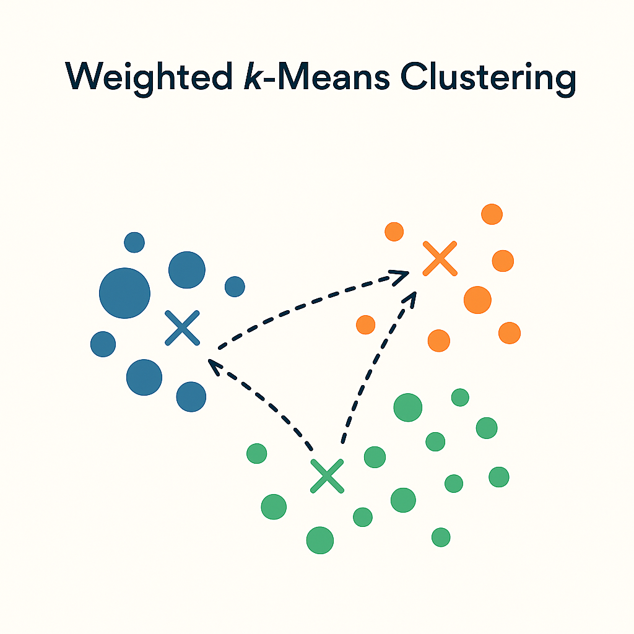


Background
Weighted K-Means Clustering
Unlike regular K-means, where cluster centers and cluster assignments are updated just on the basis of distance
Weighted k-means assigns weights to points to define their probability of belonging to one cluster over the other. This influences the cluster center updates as follows:
Idea is to reduce the loss incurred by misassignment of points (now weighted as well)
Different‑sized dots show points with different weights
Notes:
There are several clustering algorithms in literature but for this report we will focus on weighted kmeans clustering

Slide 12

Methodology
Disentanglement using LID via Total Correlation
Following the paper - L. Basile, S. Acevedo, L. Bortolussi, F. Anselmi, and A. Rodriguez, “Intrinsic dimension correlation: uncovering nonlinear connections in multimodal representations,” 2025 - it was intuitive to model Total Correlation using LID as a proxy for entropy as follows:
The correctness of this naive formulation is subject to question
TC is defined over the full data distribution, whereas LID characterizes behavior in the lower distributional tail.
For theoretical investigation, we have to study the behaviour of TC in the limit where the neighborhood radius approaches zero
Notes:
As a result, directly substituting entropy terms in the TC formulation with LID compromises the theoretical soundness and stability of the resulting metric. But this inconsistency presents an opportunity to study the behavior of TC in the limit where the radius of the neighborhood approaches zero and, perhaps, to write down in terms of LID or revealing that such a limit may not exist.

Slide 13
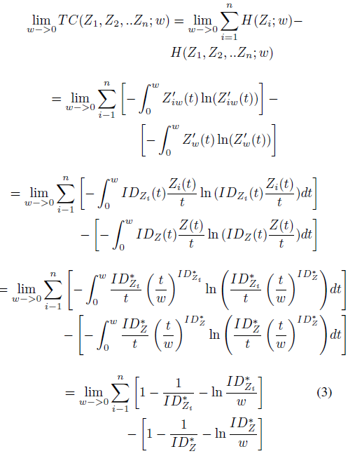
Methodology
Disentanglement using LID via Total Correlation
TC diverges as neighborhood radius tends to 0
Notes:
Much of the derivation is guided by J. Bailey, M. E. Houle, and X. Ma, “Local intrinsic dimensionality, entropy and statistical divergences,”

Slide 14


Methodology
Learning cluster-friendly latent space
To ensure that the autoencoder learns a latent space that facilitates clustering, several modifications were introduced to the baseline architecture.
During training, weighted K-means clustering was applied directly to the latent space whose loss gave us the first additional loss - the K-means loss:
The weights are assigned using the softmax function such that it gives us the similarity measure between a point and its corresponding centroid, therefore the closer the point the higher is the weight:
Notes:
As a result, directly substituting entropy terms in the TC formulation with LID compromises the theoretical soundness and stability of the resulting metric. But this inconsistency presents an opportunity to study the behavior of TC in the limit where the radius of the neighborhood approaches zero and, perhaps, to write down in terms of LID or revealing that such a limit may not exist.

Slide 15



Methodology
Learning cluster-friendly latent space
To make sure similar points are clustered together and dissimilar points are as far apart as possible, a KL divergence loss function is introduced in models like t-SNE, scDeepCluster and scziDesk
First a probability distribution of every point z_{i} belonging to the same cluster as other points in latent space is built using t-distribution kernel as follows:
An auxiliary target distribution is defined as follows:
The Kullback-Leibler (KL) divergence loss is employed to encourage the model distribution p to approximate the target distribution q.:
Notes:
where t controls the degrees of freedom, essentially giving the distribution heavier tails than that of a gaussian distribution.
The target distribution exhibits sharper tails, wherein lower probabilities become vanishingly small while higher probabilities approach unity.
The core objective is to align the distribution pj|i with the target distribution qj|i, thereby compressing the heavy tails and producing more pronounced peaks. This transformation effectively brings similar data points closer together and pushes dissimilar points further apart, enhancing cluster separation in the latent space.

Slide 16

Methodology
Learning cluster-friendly latent space
Finally, the Itakura-Saito divergence using estimated LIDs of distributions q_{j|i} and p_{j|i} as is introduced as follows:
This loss gives manifold awareness to the clusters - pulling the clusters toward a low (or uniform) target encourages the encoder to flatten out wrinkle-like variations inside a cluster, giving tighter, more linear latent shapes which are more separable.
It counter-balances KL loss terms behavior of over-tightening dense regions and neglecting sparse ones by pushing sparse zones to contract as well
It makes sure outliers (which generally have very high LID) from pulling the centroids towards them
Low LID makes sure data is tightly packed - less room for adversaries
Notes:
What this loss essentially models is that, how many degrees of freedom does a point in distribution P have relative to that of a point Q.
On data whose neighborhood sizes vary strongly, the KL term can over-tighten dense regions and neglect sparse ones; an LID term counter-balances that by pushing sparse zones to contract as well
Low LID means the data is more tightly packed and hence the there is less room for adversaries. Just optimizing P and Q leads to larger clusters swallowing the smaller ones. Keeping LID low everywhere will make sure the bigger clusters do not cover the smaller ones.
These are the theoretical guarantees we have for using the IS loss but the practical viability of this method is explored using empirical investigation.

Slide 17
Methodology
Learning cluster-friendly latent space
Finally, the Itakura-Saito divergence using estimated LIDs of distributions q_{j|i} and p_{j|i} as is introduced as follows:
This loss gives manifold awareness to the clusters - pulling the clusters toward a low (or uniform) target encourages the encoder to flatten out wrinkle-like variations inside a cluster, giving tighter, more linear latent shapes which are more separable.
It counter-balances KL loss terms behavior of over-tightening dense regions and neglecting sparse ones by pushing sparse zones to contract as well
It makes sure outliers (which generally have very high LID) from pulling the centroids towards them
Low LID makes sure data is tightly packed - less room for adversaries
Notes:
What this loss essentially models is that, how many degrees of freedom does a point in distribution P have relative to that of a point Q.
On data whose neighborhood sizes vary strongly, the KL term can over-tighten dense regions and neglect sparse ones; an LID term counter-balances that by pushing sparse zones to contract as well
Low LID means the data is more tightly packed and hence the there is less room for adversaries. Just optimizing P and Q leads to larger clusters swallowing the smaller ones. Keeping LID low everywhere will make sure the bigger clusters do not cover the smaller ones.
These are the theoretical guarantees we have for using the IS loss but the practical viability of this method is explored using empirical investigation.

Slide 18
Methodology
Two-NN estimator
We can estimate Ids using Two-NN estimator as was discussed in Background.
Briefly, the estimator operates by first computing the ratio between the distances to the second and first nearest neighbors of each data point, which is then transformed using an inverse logarithmic scale.
Subsequently, it evaluates the cumulative distribution function (CDF) of these values
relative to each point.
A line is then fitted through the origin, using the inverse log-scale ratios as the x-coordinates and the corresponding CDF values as the y-coordinates.
The slope of this line provides the estimated LID of the data. The use of only the two nearest neighbors renders the estimator highly efficient and free of tunable parameters.

Slide 19
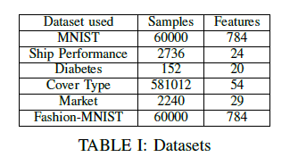
Results
Experimental setup and Datasets
A simple autoencoder architecture was developed, consisting of an encoder and decoder each containing a single hidden layer, alongside a central bottleneck layer.
Network weights were optimized using the Adam optimizer.
Training was conducted utilizing an NVIDIA A100 GPU; however CPU-based training is also feasible, with the exception of one PyTorch library dependency within the LID estimator module, which explicitly requires CUDA support.
The source code and the dataset are all available on GitHub

Slide 20
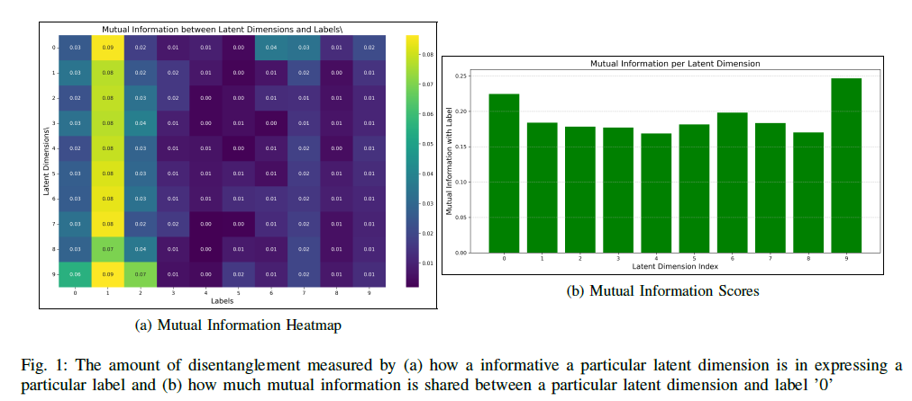
Results
Disentanglement using LID via Total Correlation
MNIST dataset was used for this experiment. In an ideally disentangled representation, each latent dimension would independently capture information pertinent to a single digit class.
Notes:
Each image was flattened into a 784-dimensional input vector and passed through an autoencoder with a bottleneck dimension of 10. In an ideally disentangled representation, each latent dimension would independently capture information pertinent to a single digit class.
most latent features disproportionately capture information associated with the digit ’1’, while exhibiting low mutual information with other labels. Moreover, the uniformity of rows in the mutual information matrix suggests that the latent features are functioning similarly, indicating an absence of feature specialization or disentanglement.
This observation is reinforced in Figure 1b, which reveals that each latent feature shares an approximately equal amount of mutual information with label ’0’, further confirming the lack of disentanglement in the learned representation.

Slide 21
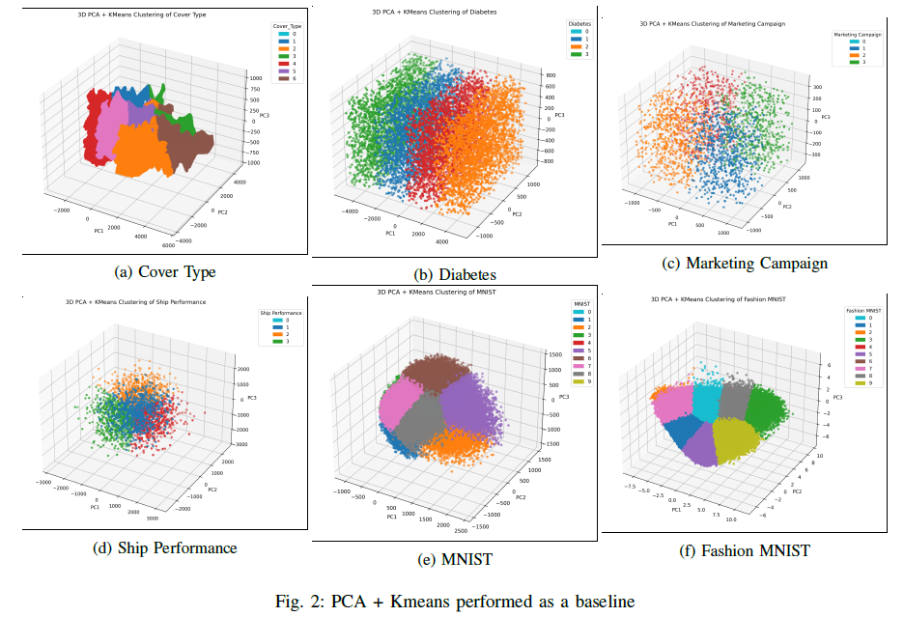
Results
Learning cluster-friendly latent space
To establish a baseline, Principal Component Analysis (PCA) was performed to reduce each dataset to three dimensions, followed by K-means clustering.
Notes:
This approach serves as a classical benchmark for clustering performance after dimensionality reduction. As shown in Figure 2, the resulting clusters appear diffuse and poorly separated, indicating limited clustering efficacy in the PCA-reduced space.

Slide 22
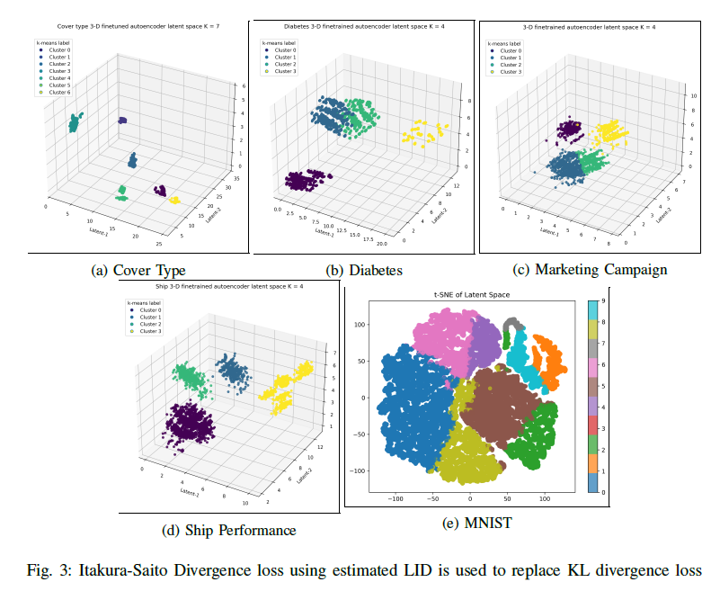
Results
Learning cluster-friendly latent space
These results are produced by a model that only uses the IS loss along with reconstruction and K-means losses.
Strong performance on Cover Type and Ship Performance dataset.
Satisfactory for Diabetes and Market.
Better than baseline for MNIST.
Notes:
Next, we analyze the latent embeddings obtained from a model trained using IS loss in place of KL loss, in conjunction with reconstruction and K-means clustering losses. The number of clusters was specified as input.
The method demonstrated strong performance on the Cover Type and Ship Performance datasets, yielding well-separated, compact clusters. Results on the Diabetes and Marketing Campaign datasets were satisfactory, though less pronounced. For MNIST, due to the high intrinsic dimensionality of the
data, reducing the bottleneck to three dimensions caused instability and significant loss. Instead, the model was trained with a bottleneck dimension of 32, and the learned latent representations were visualized in two dimensions using t-SNE. Compared to PCA+K-means, this approach provided a substantial improvement in clustering quality.

Slide 23
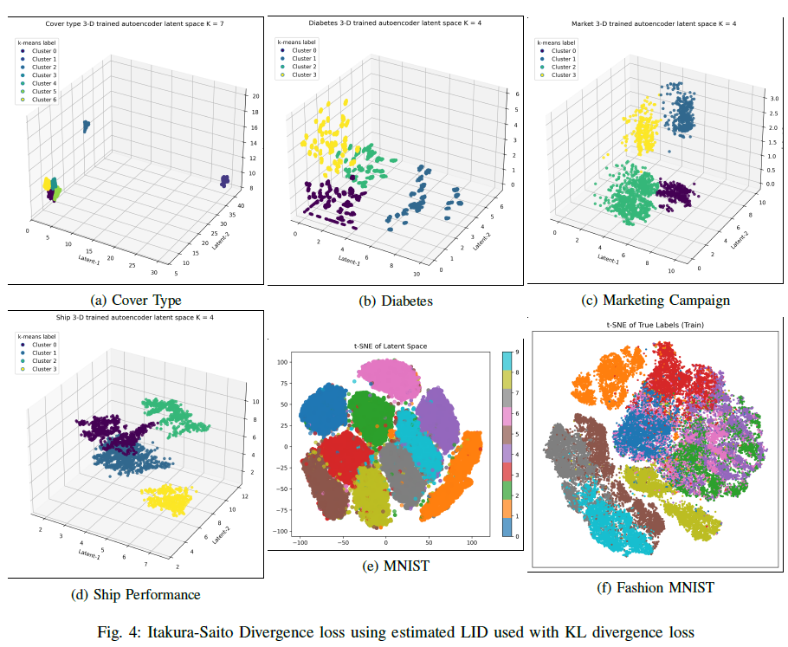
Results
Learning cluster-friendly latent space
These results are produced by a model that uses both the IS loss and KL loss along with reconstruction and K-means losses.
For Cover Type dataset, while clusters were well-defined, the IS loss overly tightened them
Performance declined on diabetes dataset
MNIST performance improved, while Fashion-MNIST performed better than baseline
Notes:
This composite objective is designed to synergize the strengths of both terms—where K-means and KL loss jointly manage cluster assignment, and IS loss enforces
compact and separable cluster geometry.
Performance on the Diabetes dataset (Figure 4b) declined, likely due to the small dataset size. In such scenarios, the IS loss received noisy and unstable targets, resulting in high variance gradients that overwhelmed the KL signal and destabilized training.
For MNIST and Fashion MNIST, the latent dimensions were again reduced to 32 before applying t-SNE for visualization. The MNIST dataset exhibited a noticeable
improvement in cluster separability compared to using IS loss alone. Fashion MNIST also demonstrated clearer cluster boundaries than PCA-based embeddings, although some overlap remained. This could be attributed to the model being trained for only 100 epochs and the lack of a deeper network architecture, which may have enabled direct compression into 2D or 3D latent space as achieved for other datasets.

Slide 24
Limitations and future work
LID ≠ TC as a disentanglement metric: Using local intrinsic dimensionality as a stand‑in for Total Correlation proved both theoretically unsound and empirically weak; LID still hints at entanglement (local ID > 1) but needs alternative, radius‑stable formulations to be useful.
Multi‑modal disentanglement: Independent encoders/decoders can map each modality to a shared latent space, letting models align visual regions with text (and similar cross‑modal links) for better interpretability and reasoning.
Limits of LID estimation: In small (number of samples) datasets or high‑dimensional datasets, Two‑NN and MLE LID estimates become numerically unstable; a single global ID is inadequate for data on multiple or nested manifolds, so LID should not be optimized as a loss term in these cases.
Post‑hoc cluster refinement: The techniques studied adjust cluster geometry after labels are set, a strategy transferable to other algorithms to yield tighter, smoother, more separable clusters without re-assigning membership.
Notes:
LID still hints at entanglement - In an ideally disentangled latent space, one expects the global intrinsic dimensionality (ID) to match the number of latent factors, while the local ID should approximate one. When two or more latent coordinates are entangled, movement along one axis influences others, resulting in a local ID greater than one. This behavior may still be leveraged in some other metric
This facilitates structured disentanglement across modalities, such as correlating specific visual regions with associated textual descriptions in vision-language models. Such architecture have the potential to improve interpretability and enhance cross-modal reasoning in deep neural systems
The diabetes dataset illustrated this instability, where erroneous LID estimates compromised the learning signal. As such, LID should not be included as an optimized loss term in these settings.
The methods explored in this report did not directly influence cluster membership assignments but rather served to refine the geometry of clusters that had already been formed. This principle of post hoc cluster refinement can be applied to other clustering algorithms to yield tighter, smoother, and more separable clusters, thereby enhancing clustering quality without altering initial label assignments.

Slide 25
Conclusion
This report explored the theoretical foundations and empirical effectiveness of utilizing Local Intrinsic Dimensionality (LID) to achieve disentangled and cluster-friendly latent representations
in autoencoders. The results indicate that directly substituting Total Correlation with LID does not provide theoretically sound or empirically effective disentanglement.
Nevertheless, incorporating Itakura–Saito Divergence alongside Kullback–Leibler Divergence has shown promising results in learning latent spaces conducive to clustering, notably
improving cluster compactness and separability.
Through comprehensive empirical analyses across diverse datasets, it was demonstrated that careful design of loss functions and architecture modifications significantly impacts the
quality of latent space representations. However, challenges remain, especially in handling small datasets or those with inherently high dimensionality. Thus, future studies should focus
on robust dimensionality estimation methods, multimodal data integration, and further refinement of clustering methods to fully exploit the capabilities of latent representation learning.

Slide 26
Resources
Images in slides 3, 5, 6 are taken from:
https://www.ibm.com/think/topics/variational-autoencoder
https://numxl.com/blogs/principal-component-analysis-pca-101/
https://www.linkedin.com/pulse/understanding-clustering-algorithms-key-techniques-bill-palifka-zw8te
https://blog.dailydoseofds.com/p/t-sne-vs-sne-whats-the-difference
https://www.v7labs.com/blog/autoencoders-guide
Images in slides 8, 10, 11 are generated using ChatGPT o3 model.
Image in slide 7 is taken from Professor Michael Houle’s lecture notes.
All other images and resources are made using the models described in the paper. The source code and datasets for the models are present in the Github repository: https://github.com/Subhodeep01/DimProj

